Slide 1
Propaganda

Slide 2
Propaganda
Propaganda definition from Merriam-Webster Dictionary:
Ideas or statements that are often false or exaggerated and that are spread in order to help a cause, a political leader, a government, etc.

Slide 3
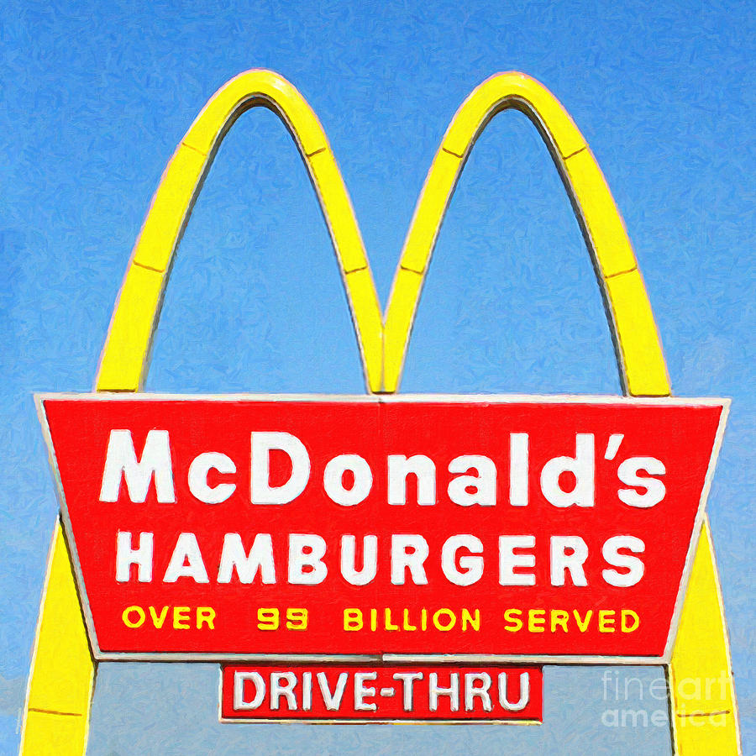
Bandwagon
To convince the audience to do or believe something because everyone else is doing it.

Slide 4
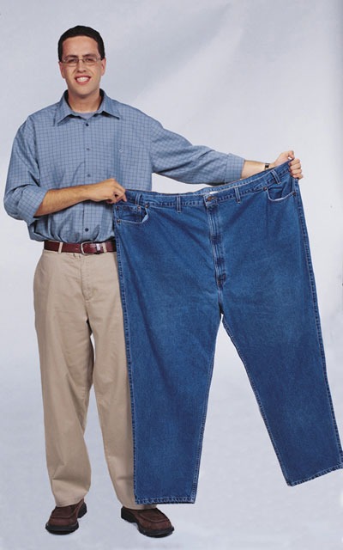
Plain folks
Suggesting something is practical and a good value for ordinary people.

Slide 5
Glittering Generalities and Transfer
Using words so strongly positive in emotional content that just hearing them makes you feel good. The words express a positive meaning without actually giving a guarantee.
Transferring good looks, feelings, or ideas to the person who the propaganda is meant to influence. Suggests the positive qualities to be associated with the product and the user.

Slide 6
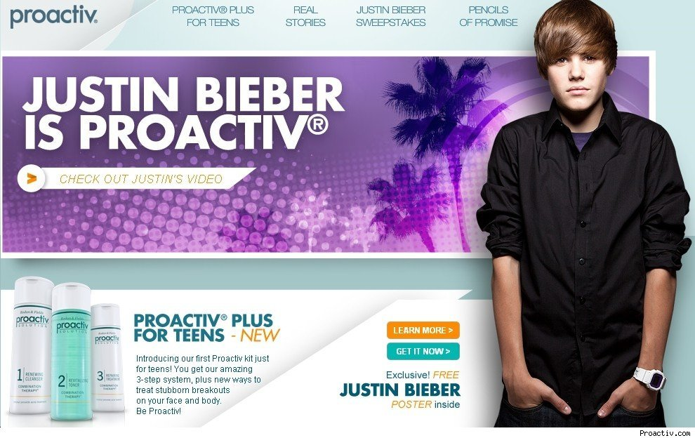
Testimonial
Using a famous person to endorse the product.

Slide 7
Repetition
Nike
Just Do It.
Just Do It.
Just Do It.
Just Do It.
Just Do It.
Just Do It.
Just Do It.
Just Do It.

Slide 8
Name calling
Self-explanatory
Calling someone or something a name, whether it’s true or not.

